Slide 1

E-AGRICULTURE
Guide:
Mr. M.M.Kulkarni
Project Submitted:
Ms. Aishwarya Savale
Ms. Vidyashri Gaur
Mr. Umesh Kumbhar
Mr. Vinay Thisake
Mr. Karan Hipale

Slide 2
What is E-Agriculture
E-Agriculture is web-based application which covers the services involved in moving an agriculture product from the farmer to the consumers.
E-Agriculture is referred to those strategies and techniques which use online ways to reach target customers. This service involves the planning, organizing, directing, and handling of agriculture produce in such a way as to satisfy farmer and customer.
This market also helps us to discover better price for the products and smooth marketing of agricultural products.
In this application farmer(Admin) can add their produced products and consumers can see the products and make their orders by entering their information, the ordered product would be at their doorstep. This application is easy to operate and understood by the users.

Slide 3
Features
Maintain records of variety of products.
Maintain customer details and orders.
Home delivery.
It is most useful to the farmers since benefits are high.
It covers large number of customers of different states.
Provides a user-friendly interface

Slide 4
Technologies
Operating System : Windows 10 or above
Programming language: ASP.net using C#
Editor: Visual Studio 2022
Backend Database: SQL Server 2018
Processor: Intel core i3 or above
Hard disk: 256GB or above
RAM: 4GB or above

Slide 5
Admin Site Modules
Admin: Admin is a Responsible person to run the whole system. Admin can add, delete, update all information related to the system like category, Product Information.
Login
Dashboard
Manage
Category
Manage Products
Manage Orders
View Feedbacks
Change Password

Slide 6
User Site Modules
User/Customer: User is Visitor who visit the site and buy something from our website by making a payment (Cash on Delivery).
Registration
Login
View Products
Make Order
Manage Profile
Give Feedback
Change Password

Slide 7
Working
The working is as follows:
Takes the necessary information from the UI/Front End
Maintain records of variety of products.
Maintain customer details and orders.
Provides the output

Slide 8
Future Scope
Implementation of Debit/Credit payment modes: Debit and credit will be implemented in future.
Payment Gateway: The implementation of payment gateway is not possible right now, it will be implemented in future.

Slide 9
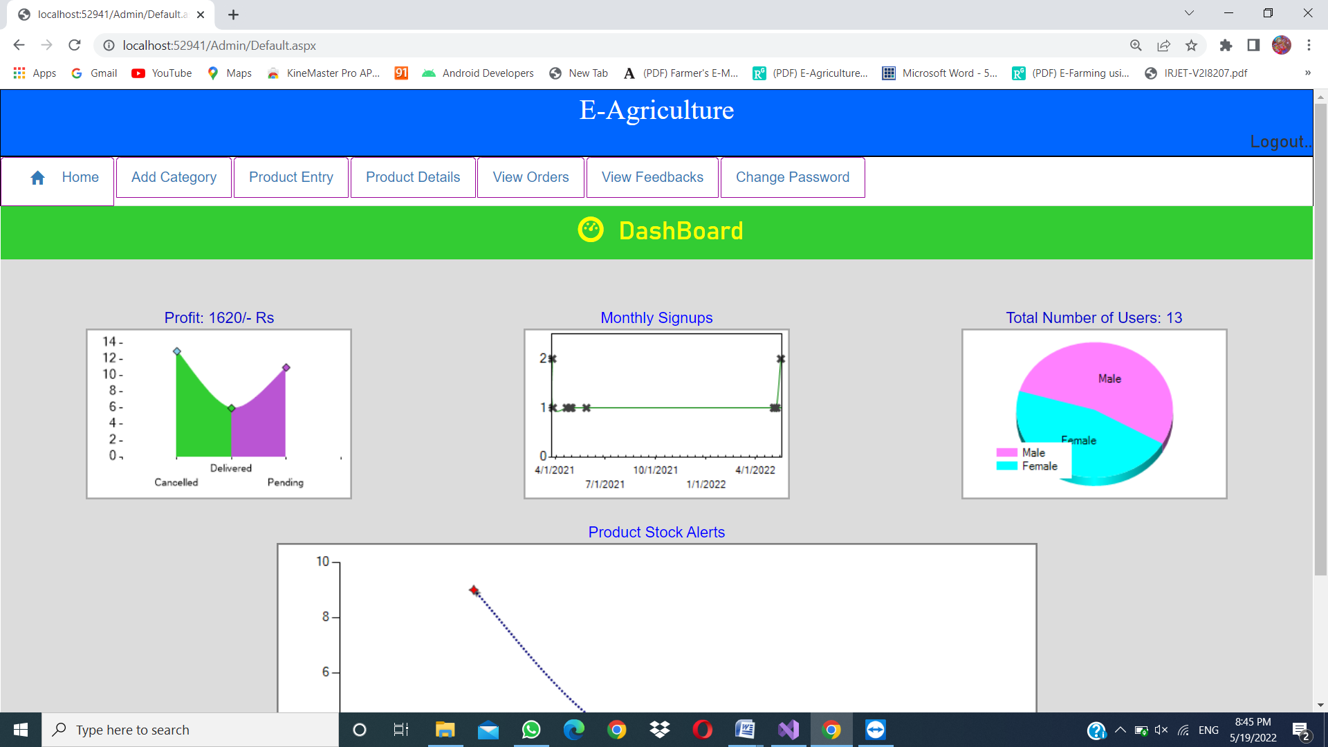
Output of Admin Home Page

Slide 10
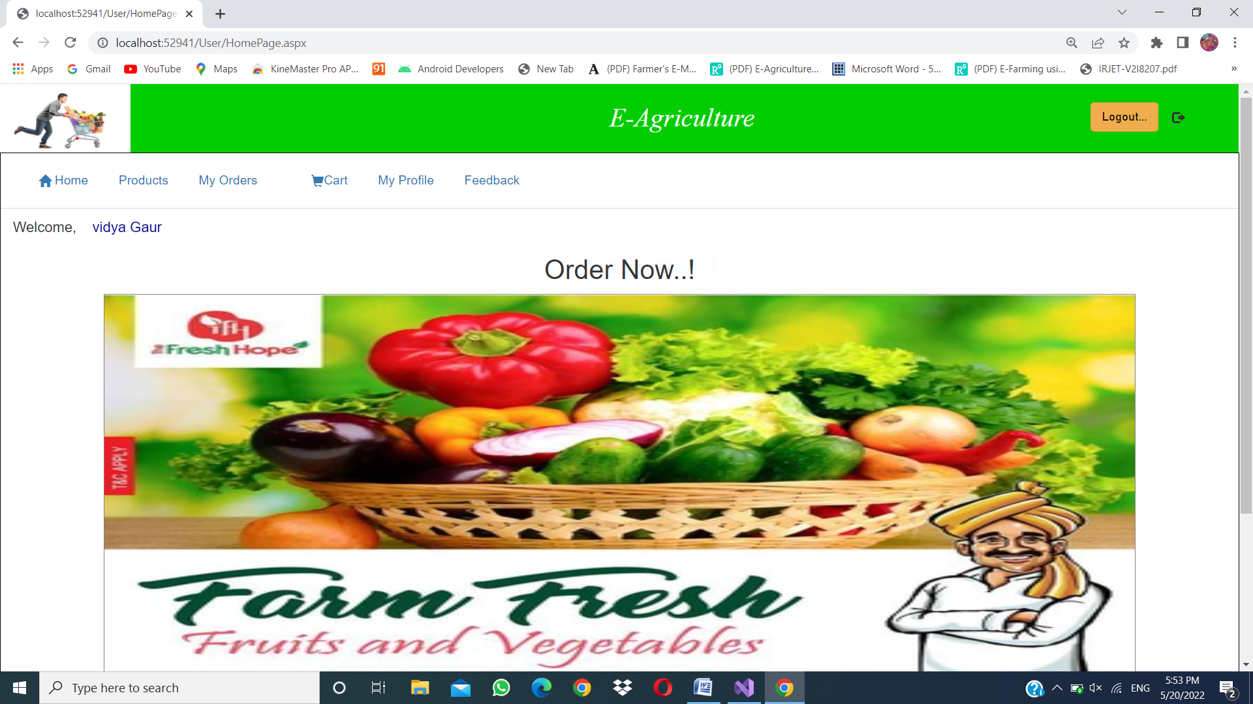
Output of User Home Page

Slide 11
Application
Provides user friendly site for the marketing purpose.
Each channel has its own unique audience that sellers can reach. An online site can help you reach a new customer.
E-Agriculture allows them to visit the same store virtually, with just a few mouse clicks.
This application is easy to operate and understood by the users.

Slide 12
Conclusion
In our project the user can access all information about the Products and Order the required Products.
To develop this project, we have faced many problems but we hardly tried to develop this project. Our supervisor helps us by giving this valuable opinion, decision and time.
The availability of online shopping has produced a more educated consumer that can shop around with relative ease without having to spend a large amount of time.

Slide 13
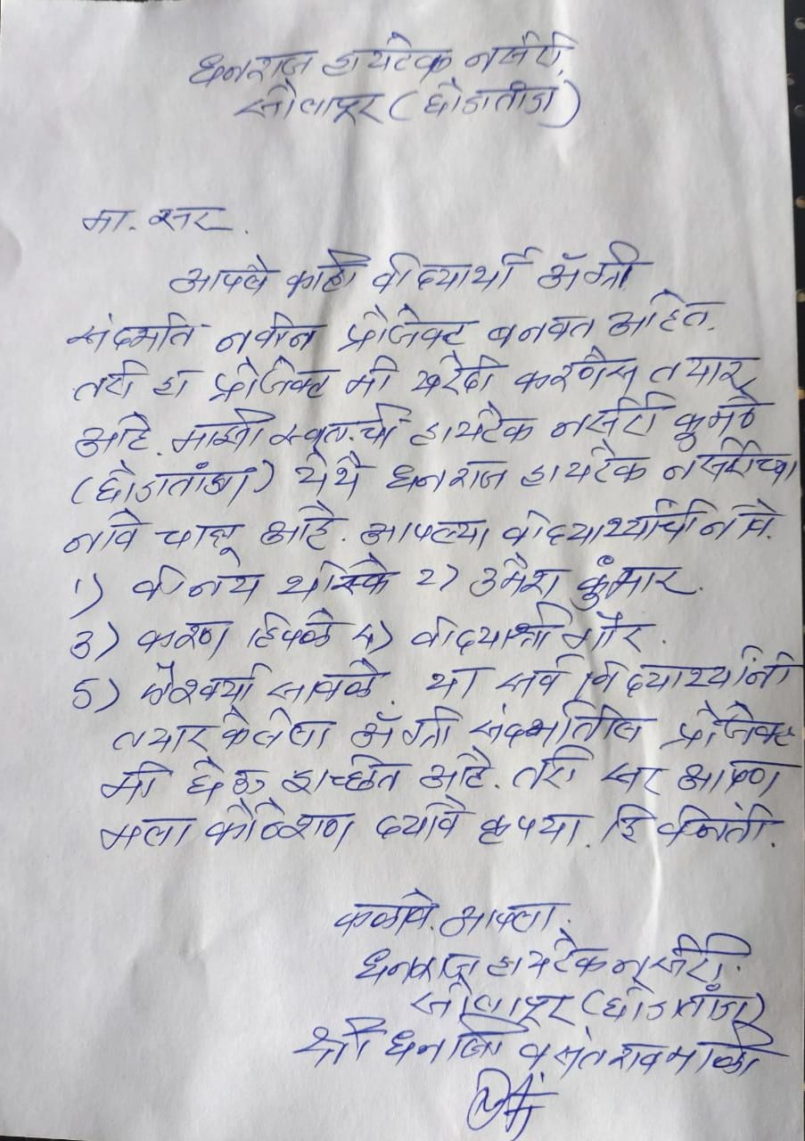
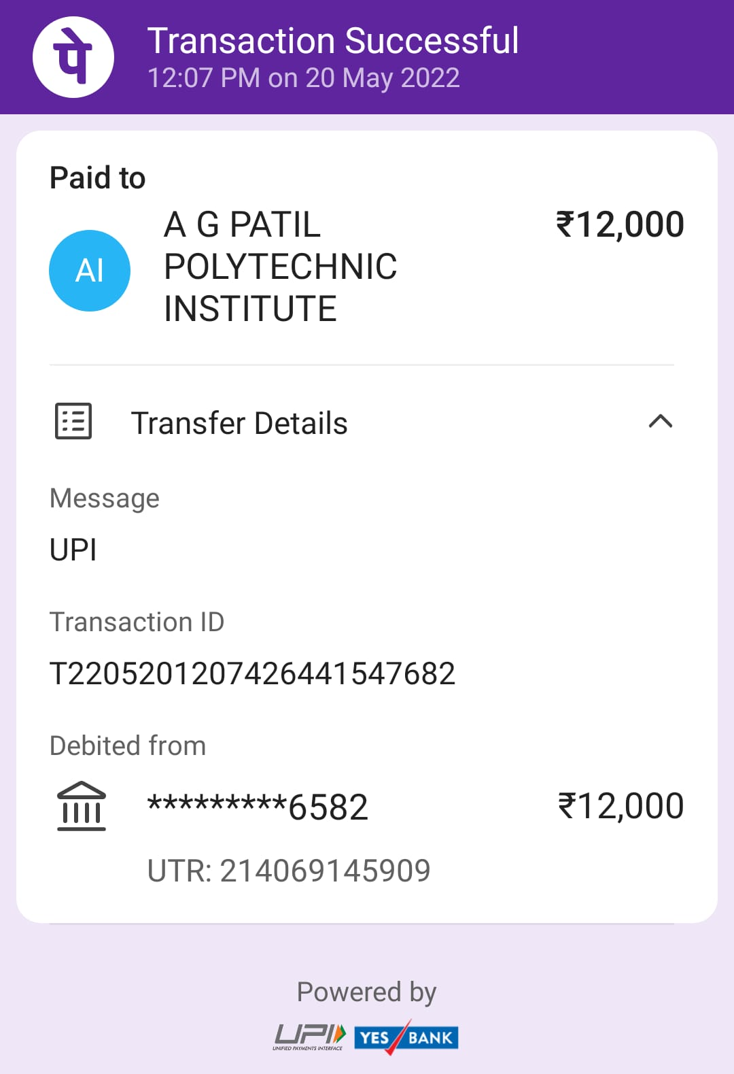

Slide 14
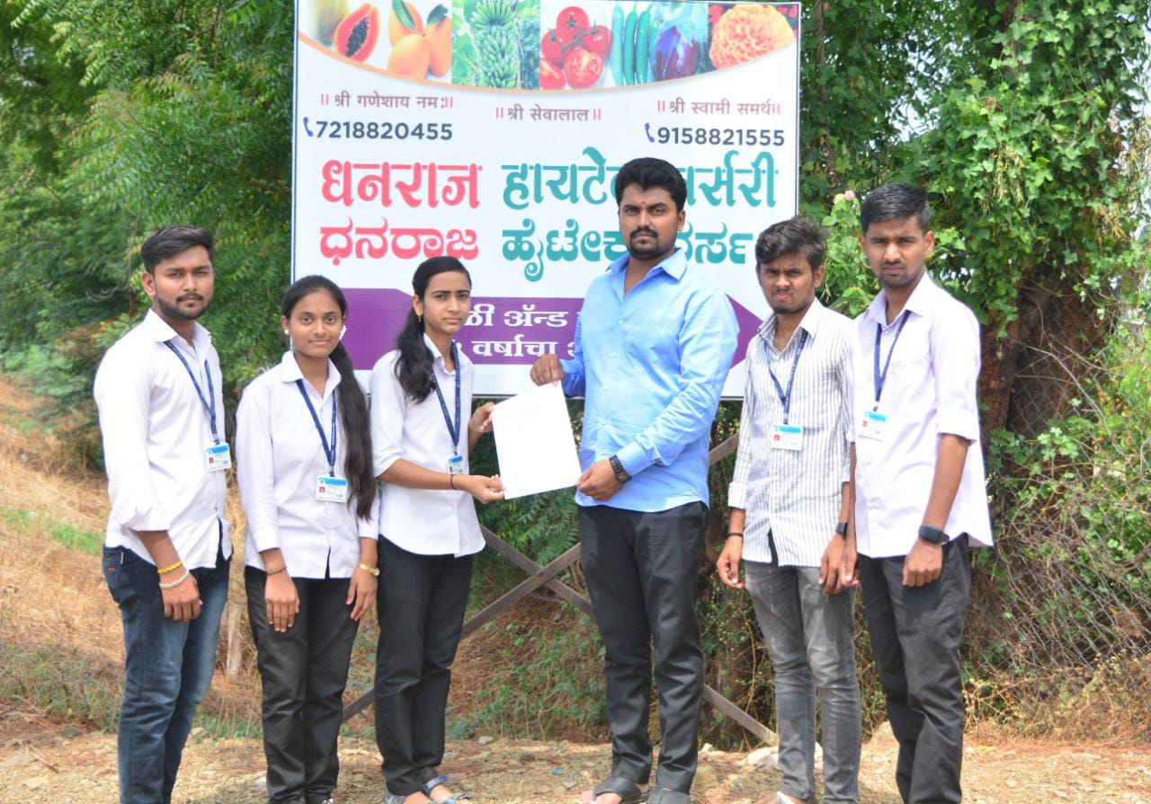
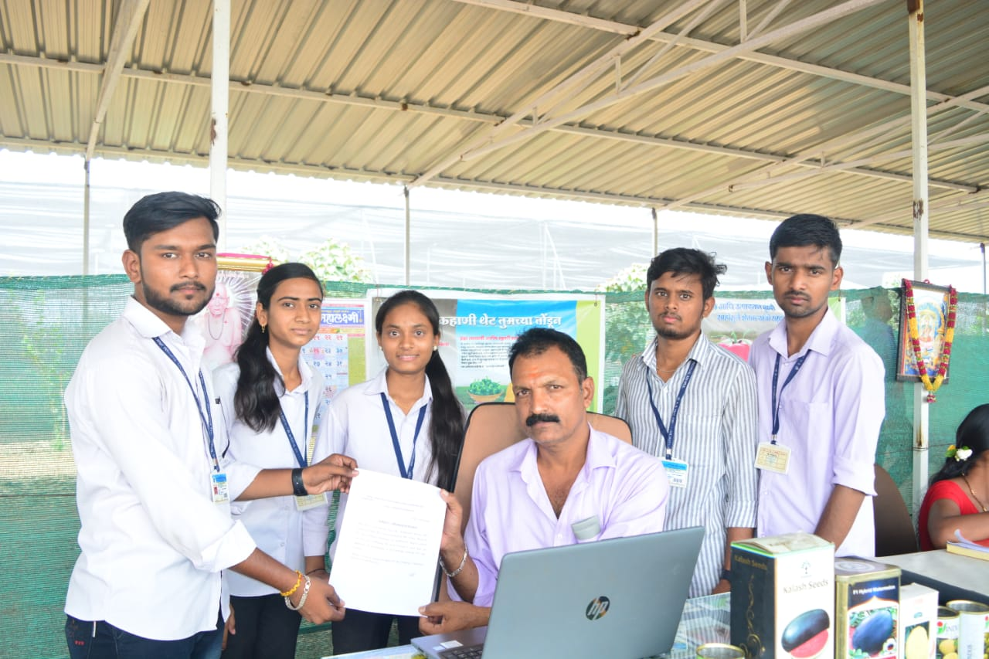
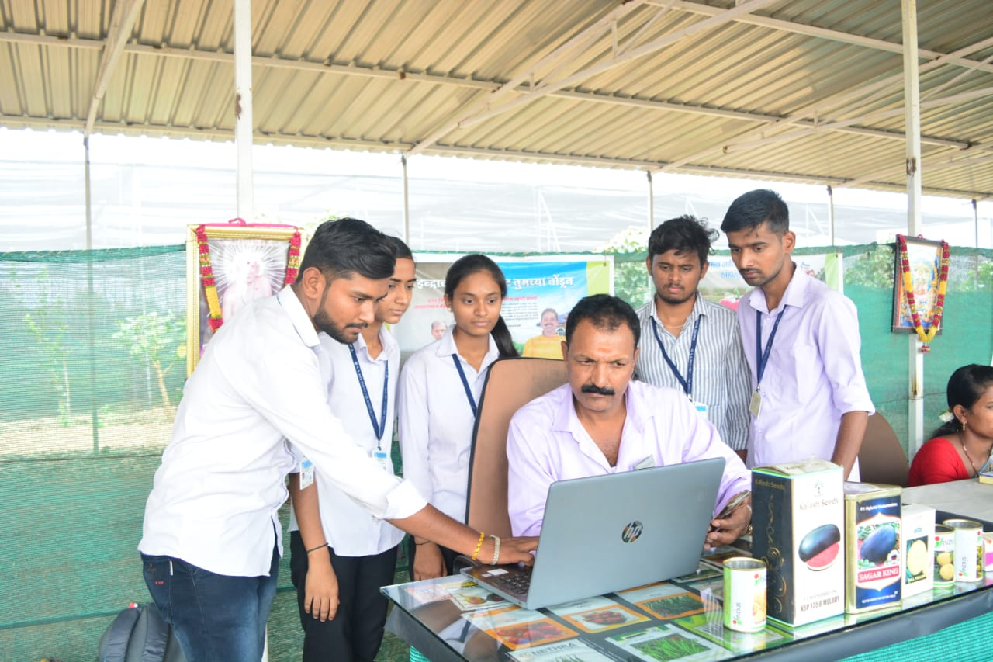

Slide 15
THANK YOU

